Slide 1
Project Title: SmilePoint Dental Clinic Project Sponsor: Clinic Owner Project Manager: Jane Doe Business Analyst: Oluwafunmilayo Animashaun

Slide 2
Business Problems To Be Solved
The business problems Smile Point Dental Clinic is trying to solve by implementing an online appointment booking portal are :
Inefficient manual scheduling processes that cause long patient wait times
Frequent booking errors
High staff workload
Missed appointments
Lost revenue
Damaged reputation
Limited ability to scale operations.

Slide 3
Stakeholders Involved In This Project & Why
Stakeholders | Goals | Concerns
Patients | convenience, speed, privacy. | data security, difficult interface, losing personal interaction.
Reception/Admin Staff | less repetitive phone work, fewer mistakes. | learning curve, fear of reduced hours/job security.
Dentist/Clinical Staff | predictable schedule, fewer no-shows. | system glitches causing overbooking, workflow disruption.
Clinic Management/Owners | cost savings, higher revenue, modern image. | budget overrun, slow ROI, compliance risks.
IT/Technical Team | clean technical delivery. | scope creep, integration issues.
Regulatory Bodies | legal compliance. | breach risks (low day-to-day involvement).

Slide 4
Communication Plan.
This table shows a structured way on exactly who gets what information, through which channel, how often, and who is responsible for sending it.
Identified who needs communication (stakeholders).
Determined what information each needs (status, training, benefits, risks).
Chose how (method/channel) — tailored to audience: executives get meetings/dashboards,
staff get workshops/WhatsApp, patients get SMS/posters.
Set when/how often — more frequent for high-impact groups during transition.
Assigned who delivers it (usually PM or BA owns coordination).

Slide 5
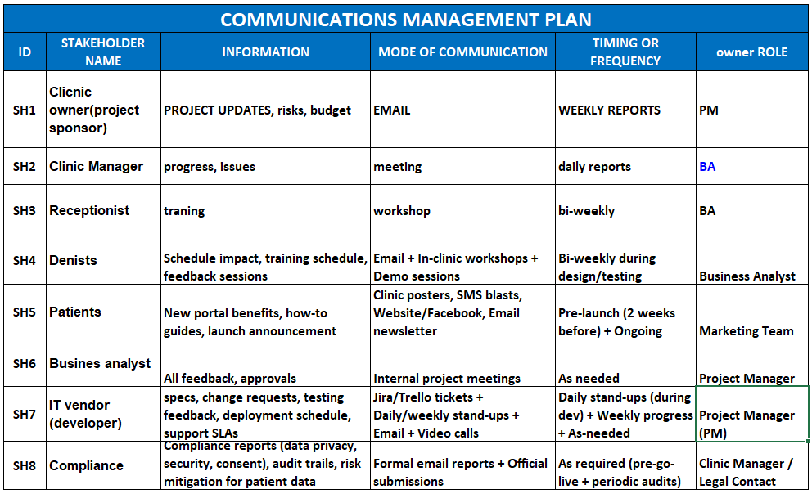

Slide 6
RACI Matrix
RACI = Responsible (does the work), Accountable (owns outcome, one per task), Consulted (provides input), Informed (kept updated).
Accountable almost always Sponsor or PM for high-level, PM for execution.
Responsible goes to the person/group actually performing (BA for requirements, Dev for build, Recep/Dent for UAT/training).
Consulted for subject-matter experts (users for requirements/testing).
Informed for those who only need awareness.

Slide 7
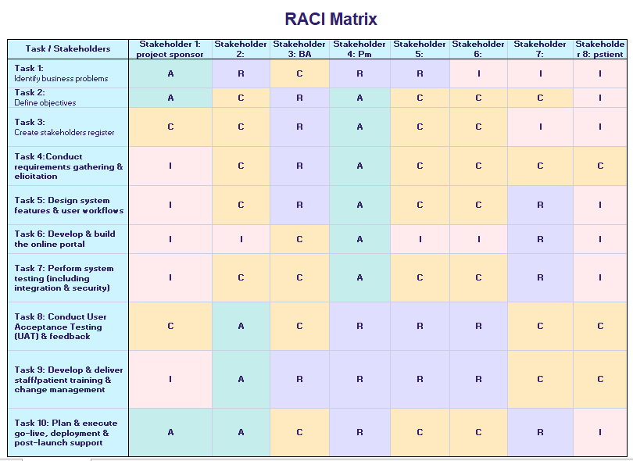

Slide 8
Stakeholder Analysis Matrix Using Power/Interest.
Power/Interest Grid is a classic 2×2 matrix (from stakeholder management theory): Y-axis: Power (ability to influence/stop project) — high/low. X-axis: Interest (how much they care about outcomes) — high/low.
Placement logic (based on case):
High Power + High Interest → Clinic Management/Owners (fund, decide, most at stake).
High Power + Low Interest → Regulators (can enforce rules but not day-to-day involved).
Low Power + High Interest → Patients, Reception, Dentists (strongly affected, adoption critical, but can't stop project).
Low Power + Low Interest → General public/competitors (monitor only).

Slide 9
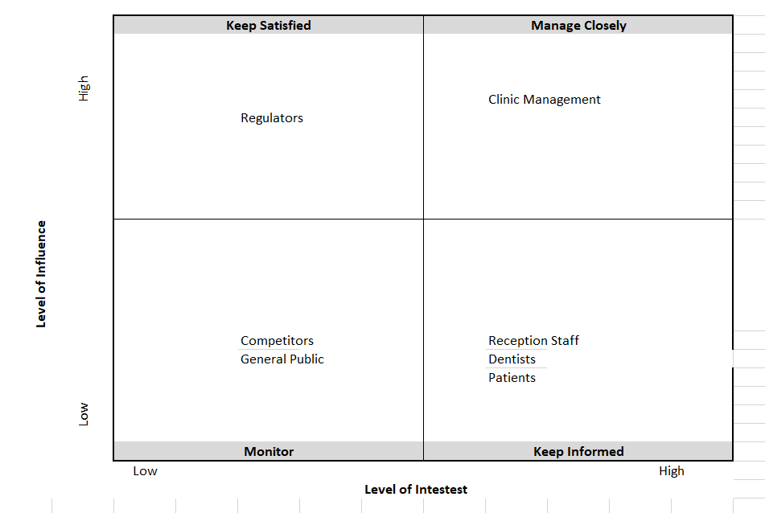

Slide 10
Thank You

